Slide 1
Project: Figbook Client: Figtory Animation Team: Creativate
Armand Pieterse 12167844 Kgomotso Sito 12243273 Jimmy Peleha 12230830 Sphelele Malo 12247040 Ndivhuwo Nthambeleni 10001183

Slide 2
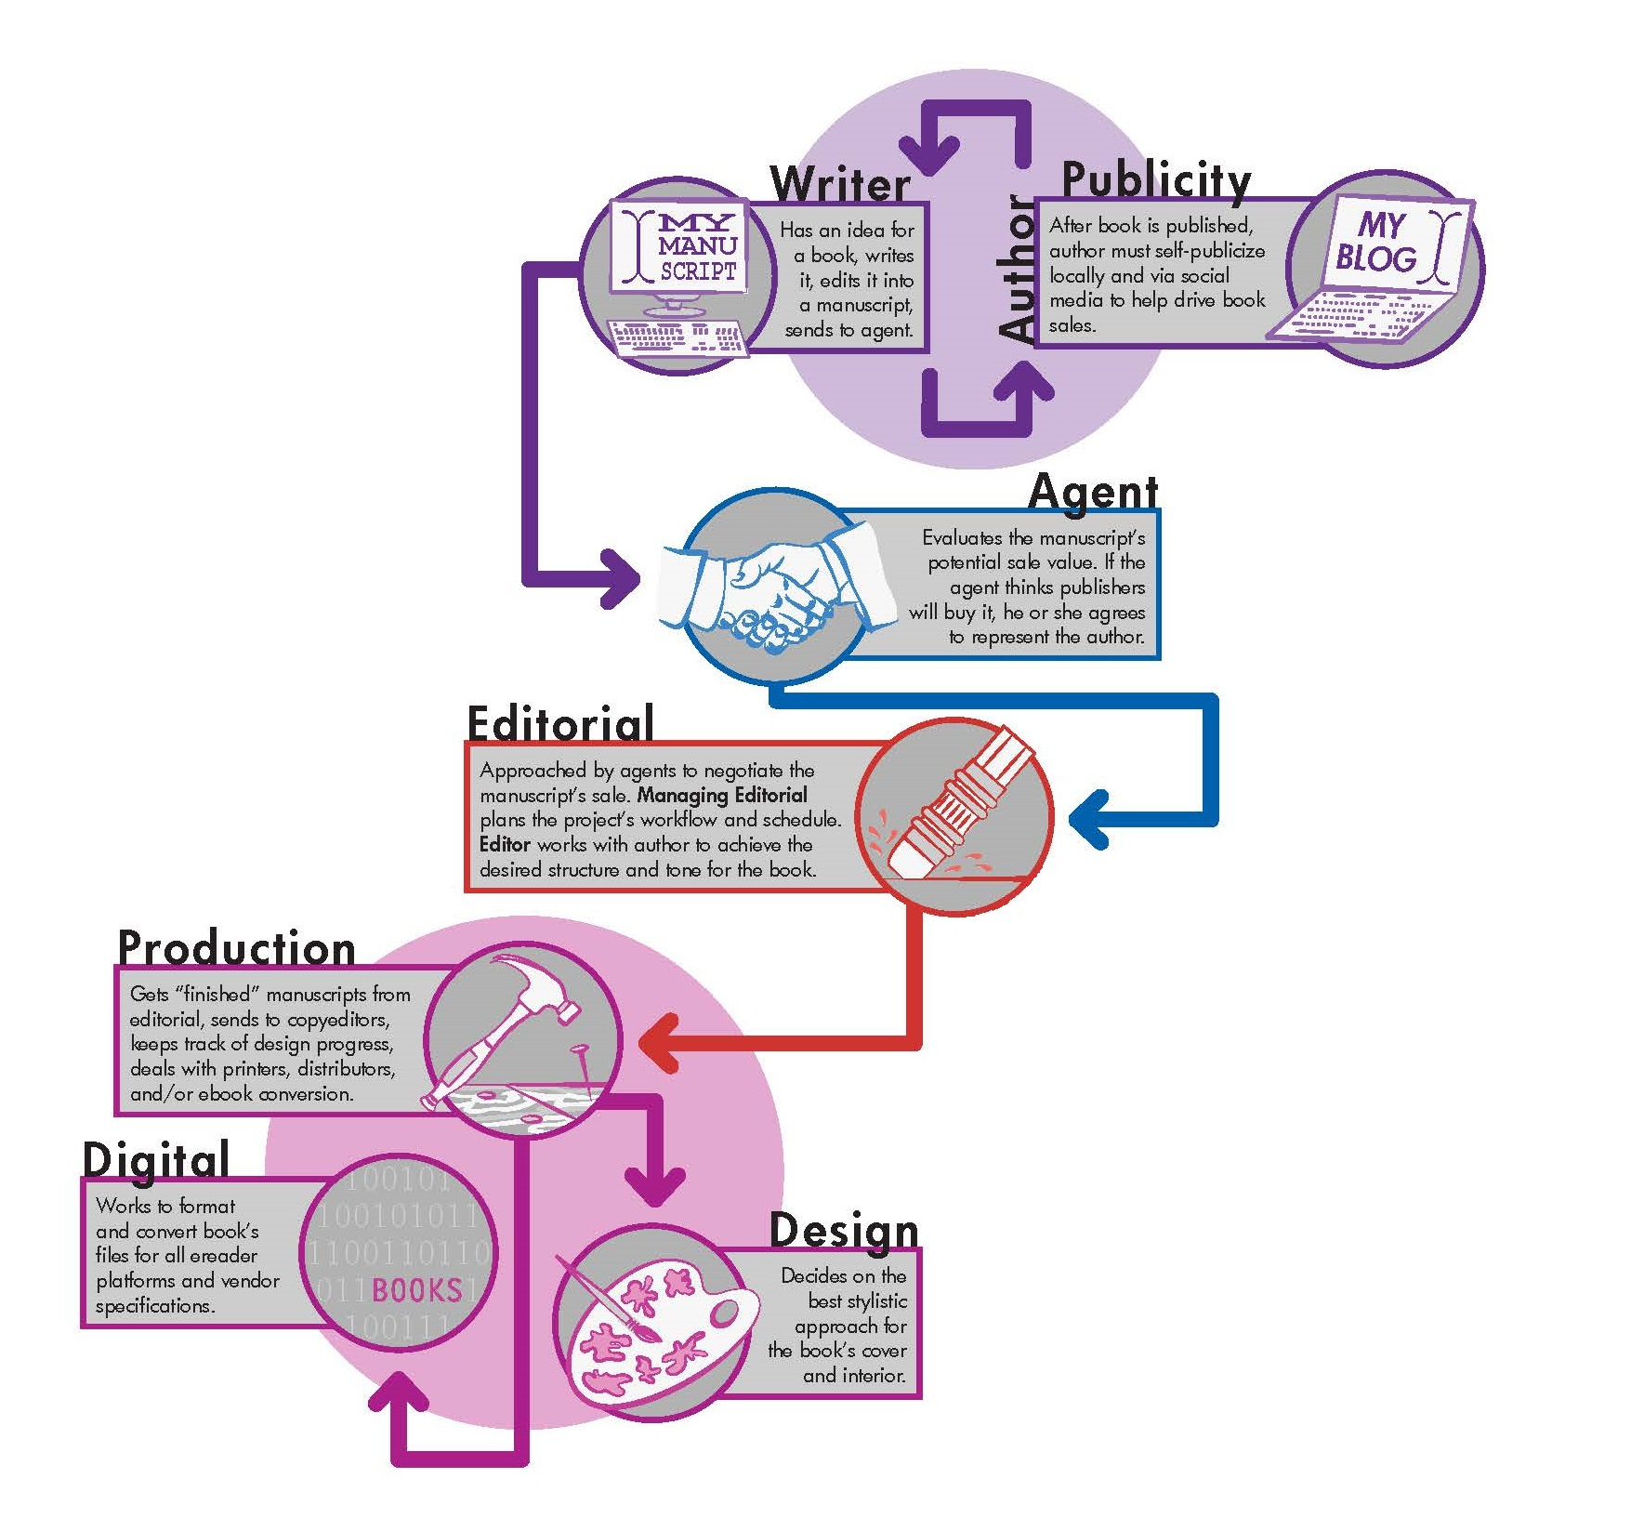
Book Publishing Life Cycle

Slide 3
Project Scope
The core of this project is to allow :
multiple authors to work on a book concurrently.
smooth communication between different user roles at the different phases of the books life cycle.
the authors to work on and see their project go from its infancy to the design and finally publishing phase.

Slide 4
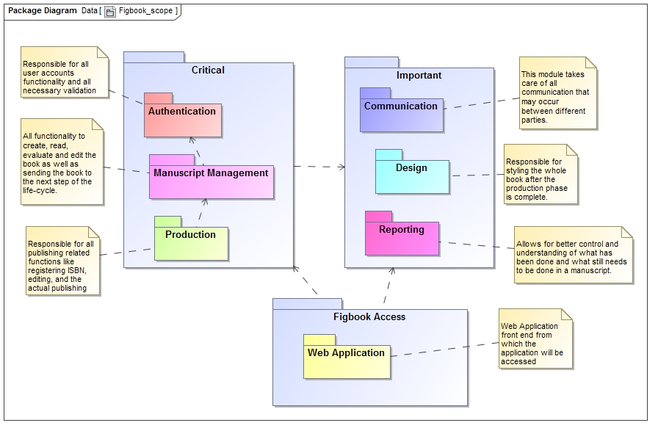

Slide 5
Project Modules
Authentication
Manuscript Management
Communication
Reporting
Production
Design

Slide 6
Thank you
Questions?

